Slide 1
BLUE TEAM
SUMMARY OF OPERATIONS
MONITORING, ANALYSIS AND MITIGATION OF A VULNERABLE NETWORK
Notes:
Over view of Blue Team ops

Slide 2
TABLE OF CONTENTS
This document contains the following resources:
Blue Team Operations
Network Topology
Description of Targets
Monitoring the Targets
Patterns of Traffic and Behavior
Suggestions for Going Further

Slide 3

Blue Team Operations
Defenders of the System
Analysis of Information Systems to ensure security
Identify security flaws
Implement and Verify effective security measures
Continue monitoring of the system to ensure system security
Notes:
Role of the Blue team - defend the system
Identify , Analyze and implement security measures
Monitor

Slide 4
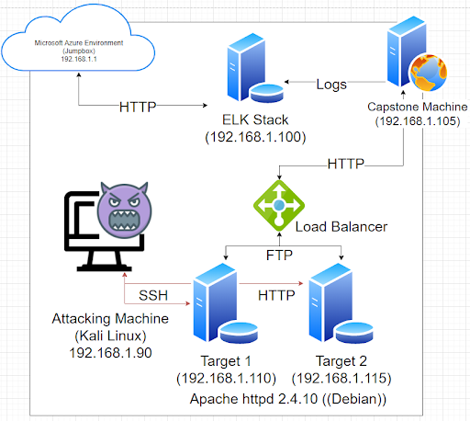
Network
Address Range: 192.168.1.1/24
Netmask: 255.255.255.0
Gateway: 10.0.0.1
Machines
IPv4: 192.168.1.90
OS: Linux Kali 5.4.0-kali3
Hostname: Kali
IPv4: 192.168.1.105
OS: Ubuntu 18.04.4 LTS
Hostname: Capstone
IPv4: 192.168.1.100
OS: Ubuntu 18.04.4 LTS
Hostname: ELK
IPv4: 192.168.1.110
OS: debian 3.16.0-6-amd64
Hostname: Target 1
IPv4: 192.168.1.115
OS: debian 3.16.0-6-amd64
Hostname: Target 2
NETWORK TOPOLOGY
NETWORK TOPOLOGY
Notes:
Blue team is primarily concerned with targets, and the ELK stack

Slide 5
DESCRIPTION OF TARGETS:
[TARGET1]
Operating System: Linux (Apache httpd 2.4.10 (Debian))
Purpose: Apache Web Server/Wordpress Redundancy
IP Address: 192.168.1.110
[TARGET2]
Operating System: Linux (Apache httpd 2.4.10 (Debian))
Purpose: Apache Web Server/Wordpress Redundancy
IP Address: 192.168.1.115
Two VMs on the network were vulnerable to attack: Target 1 [192.168.1.110] and Target 2 [192.168.1.115].
Each VM functions as an Apache web server and has SSH enabled, so ports 80 and 22 are possible ports of entry for attackers.
Notes:
Targets are Wordpress Redundancies on IPs 192.168.1.110 and .115

Slide 6
OTHER MACHINES:
[ATTACKING MACHINE]
Operating System: Kali Linux
Purpose: Threat Actor
IP Address: 192.168.1.90
[ELK Stack]
Operating System: Ubuntu Linux
Purpose: Data Ingestion, Logging, Systems Analysis Intrusion Detection System
IP Address: 192.168.1.100
[Capstone]
Operating System: Ubuntu Linux
Purpose: Sending logs to ELK Stack/Apache Web Server
IP Address: 192.168.1.105
[Azure Machine]
Operating System: Microsoft Windows RPC
Purpose: Jump Box/Azure Cloud Environment
IP Address: 192.168.1.1
Notes:
Other machines used
Primary machine is the ELK Stack

Slide 7
Monitoring the Targets:
Identified ports and associated services as potential points of entry:
Target 1
Port 22/tcp - ssh
Port 80/tcp - http
Port 111/tcp - rpcbind
Port 139/tcp - netbios-ssn Samba
Port 445/tcp - netbios-ssn Samba
Target 2
Port 22/tcp - ssh
Port 80/tcp - http
Port 111/tcp - rpcbind
Port 139/tcp - netbios-ssn Samba
Port 445/tcp - netbios-ssn Samba

Slide 8
Monitoring the Targets:
ELK Stack Server/ Apache Server
ELK STACK SERVER: OPEN SOURCE DATA MANAGEMENT TOOL
Elasticsearch, Logstash, and Kibana. Elasticsearch is a search and analytics engine. Logstash is a server‑side data processing pipeline that ingests data from multiple sources simultaneously, transforms it, and then sends it to a "stash" like Elasticsearch. Kibana lets users visualize data with charts and graphs in Elasticsearch.
DATA STORAGE
SEARCH and ANALYTICS ENGINE
DATA ANALYSIS
VISUALIZATION OF DATA ANALYSIS
REAL TIME SYSTEMS MONITORING DASHBOARD
Intrusion Detection System (IDS) capable

Slide 9
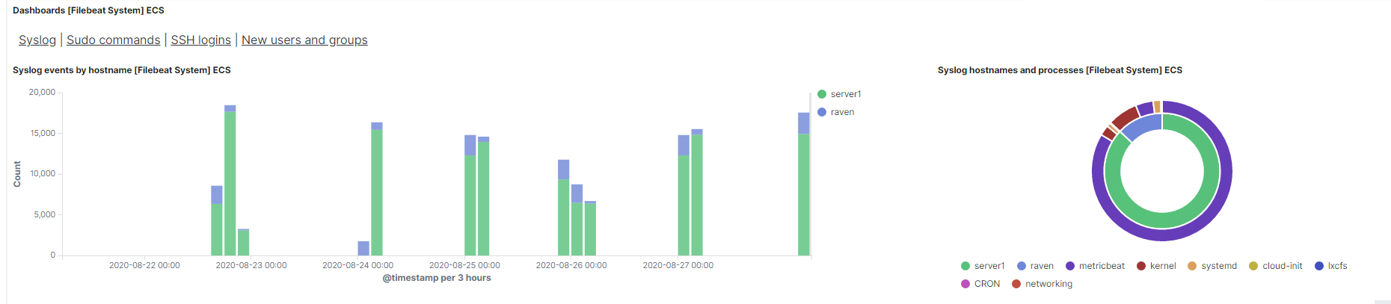
ELK MONITORING TOOLS
Primary Monitoring Tools Utilized in Kibana
FILEBEAT - Monitors the log files or locations that you specify, collects log events, and forwards them either to Elasticsearch or Logstash for indexing.
PACKETBEAT - A real-time network packet analyzer that you can use with Elasticsearch to provide an application monitoring and performance analytics system.
METRICBEAT - Collect metrics from the operating system and from services running on the server.
Filebeat Dashboard

Slide 10
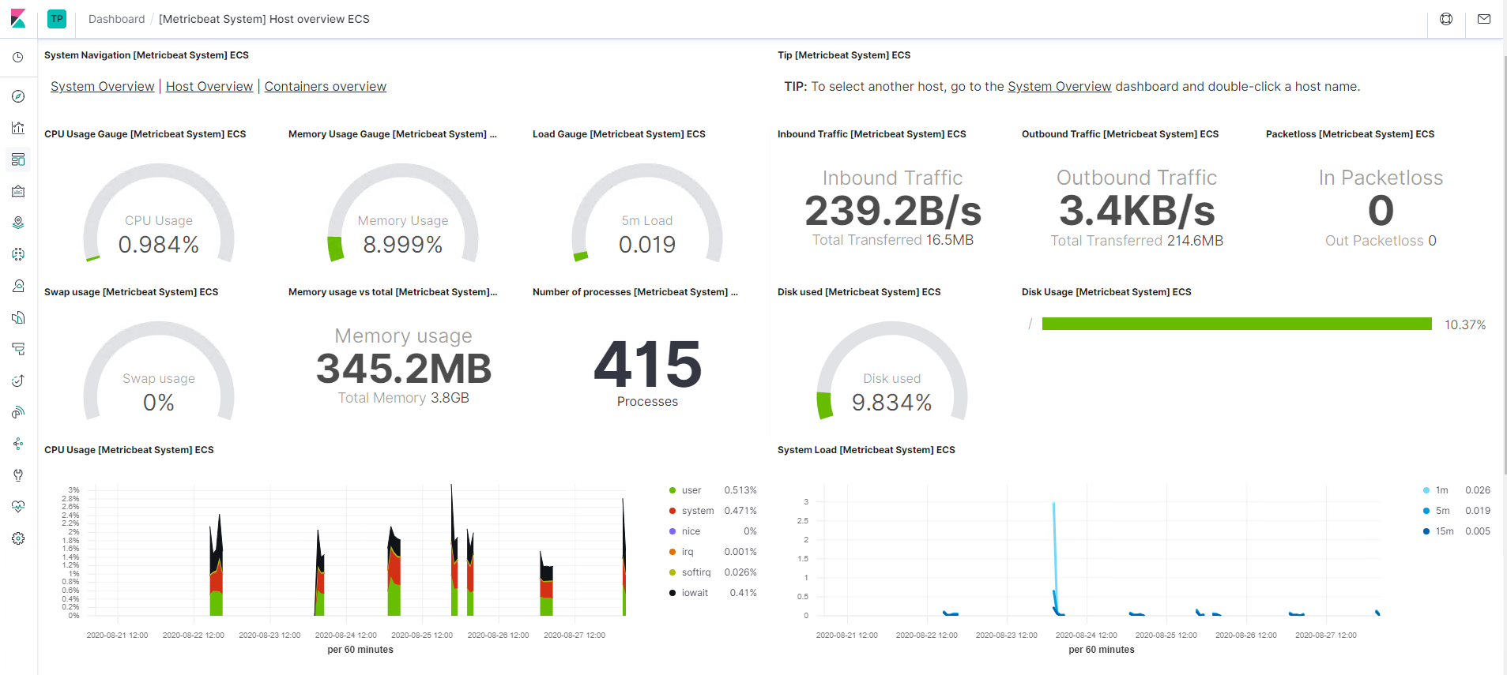
KIBANA DASHBOARD
Visualize Your monitoring systems

Slide 11
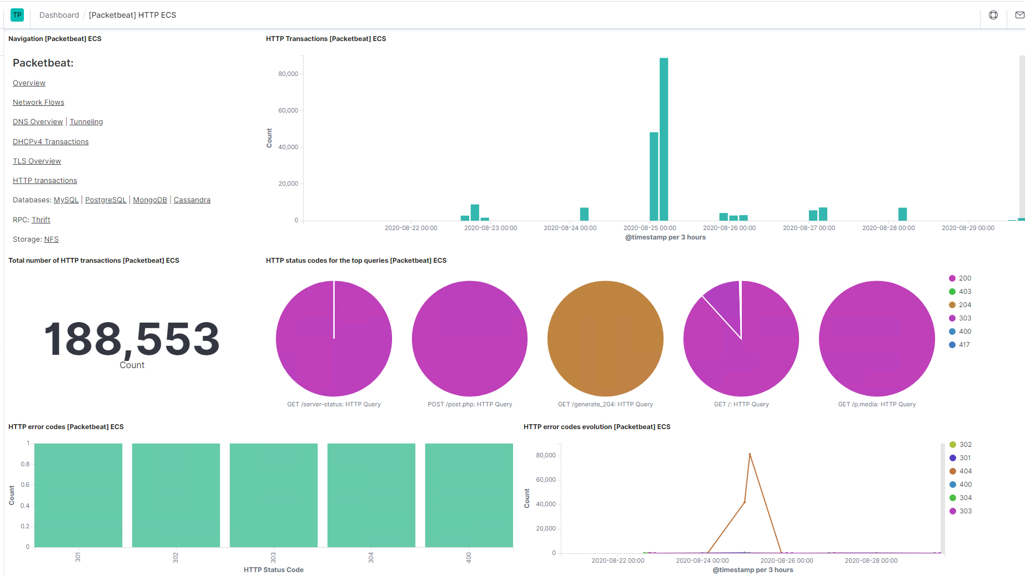
Packetbeat Dashboard
Visualization of HTTP Traffic

Slide 12

MONITORING THE TARGETS:
Traffic to these services should be carefully monitored. To this end, alerts below have been implemented:
Name of Alert 1
Excessive HTTP Errors
Excessive HTTP Errors is implemented as follows:
Metric: Excessive HTTP Errors WHEN count() GROUPED OVER top 5 'http.response.status_code' IS ABOVE 400 FOR THE LAST 5 minutes
Threshold: exceeds 400/ 5minutes
Vulnerability Mitigated:
Reliability: high reliability.

Slide 13
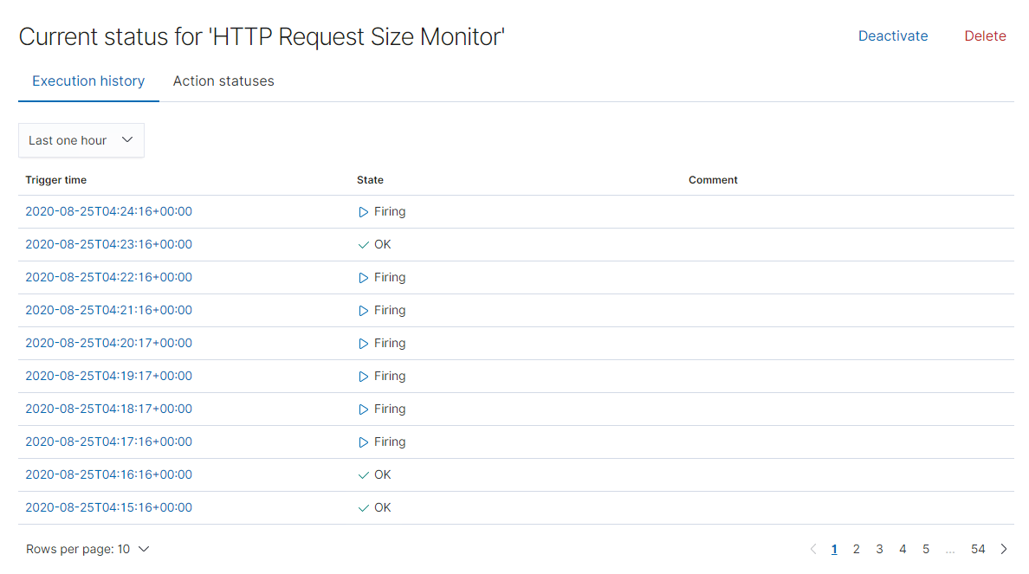
Name of Alert 2
HTTP Request Size
Request Size Monitor is implemented as follows:
Metric: HTTP Request Size Monitor WHEN sum() of http.request.bytes OVER all documents IS ABOVE 3500 FOR THE LAST 1 minute
Threshold: Sum Exceeds 3500 bytes in the last 1minute
Vulnerability Mitigated:
Reliability: high reliability, if baseline and thresholds are set correctly

Slide 14
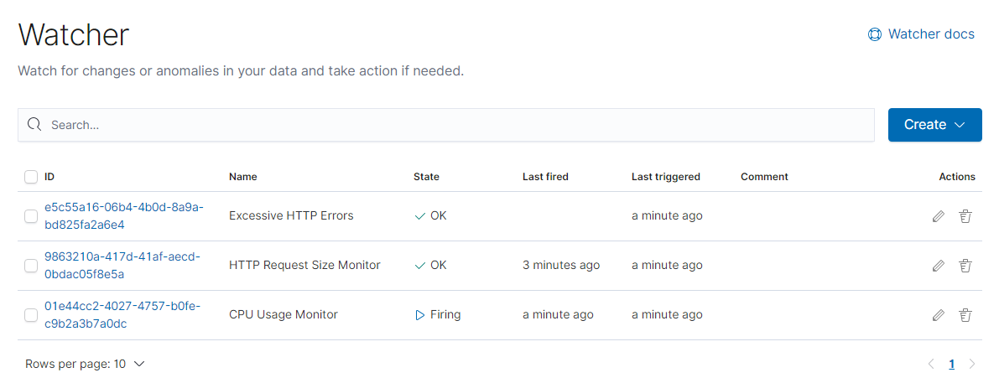
Name of Alert 3
CPU Usage Monitor
CPU usage is implemented as follows:
Metric: CPU Usage WHEN max() OF system.process.cpu.total.pct OVER all documents IS ABOVE 0.5 FOR THE LAST 5 minutes
Threshold: Exceeds 0.5 % of total system processes for the last 5 minutes
Vulnerability Mitigated:
Reliability: TODO: high reliability.

Slide 15
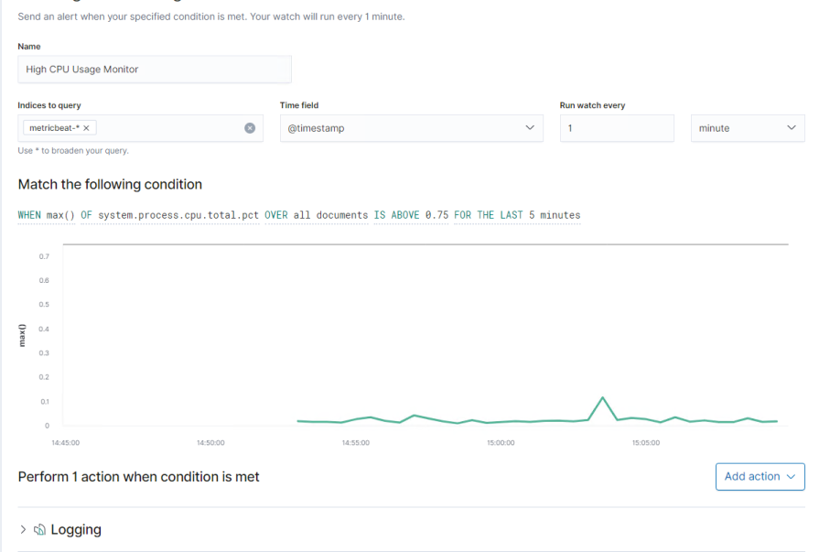
Name of Alert 4
High CPU Usage Monitor
CPU usage is implemented as follows:
Metric: WHEN max() OF system.process.cpu.total.pct OVER all documents IS ABOVE 0.75 FOR THE LAST 5 minutes
Threshold: Exceeds 75% of total system processes for the last 5 minutes
Vulnerability Mitigated: added alert to show higher usage
Reliability: high reliability.

Slide 16
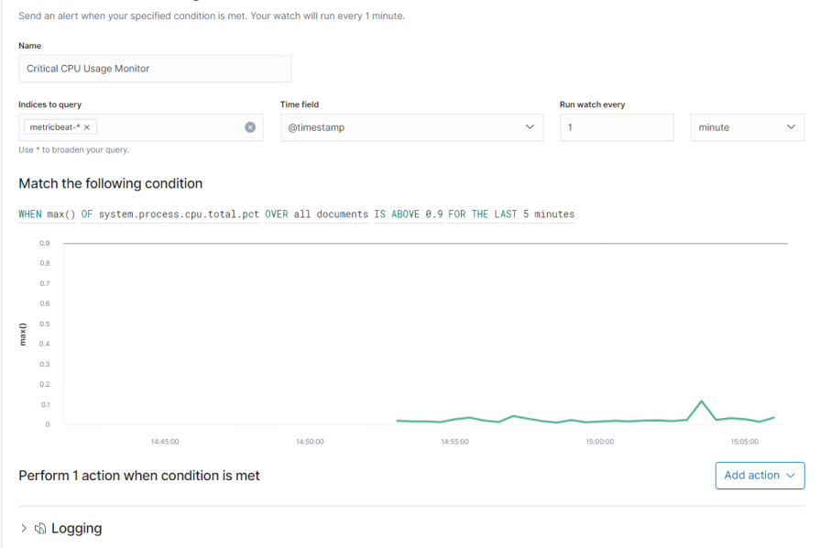
Name of Alert 5
Critical CPU Usage Monitor
CPU usage is implemented as follows:
Metric: WHEN max() OF system.process.cpu.total.pct OVER all documents IS ABOVE 0.9 FOR THE LAST 5 minutes
Threshold: Exceeds 90% of total system processes for the last 5 minutes
Vulnerability Mitigated: added alert to show critical usage
Reliability: high reliability.

Slide 17
Suggestions for Going Further
The logs and alerts generated during the assessment suggest that this network is susceptible to several active threats. In addition to watching for occurrences of such threats, the network should be hardened against them. The Blue Team suggests that IT implement the fixes below to protect the network:
Vulnerability 1: Port 111 (Portmapper) rpcbind
Patch: install special-security-package with apt-get
Why It Works: special-security-package scans the system for viruses every day
Other suggestions: add IPTables to deny TCP connection of unwanted IP ranges
Vulnerability 2: Port 139 (NetBIOS) NBSTAT
Patch: chmod 600 /var/www/html/wordpress/wp-config.php
Why It Works: By changing the permissions on the config file, only the owner would have full access while all other privileges would be denied to all outside users.
Other suggestions: turn off File and Print Sharing, block ports 137-139 completely or use strong passwords
Vulnerability 3: Port 445 (SMB)
Patch: restrict access to TCP port 445 (SMB)
Why it Works: Prevents file and printer sharing from unauthorized users
Other suggestions: delete HKLM\System\CurrentControlSet\Services \NetBT\Parameters\TransportBindName (value only) in the Windows Registry

